Slide 1


Slide 2
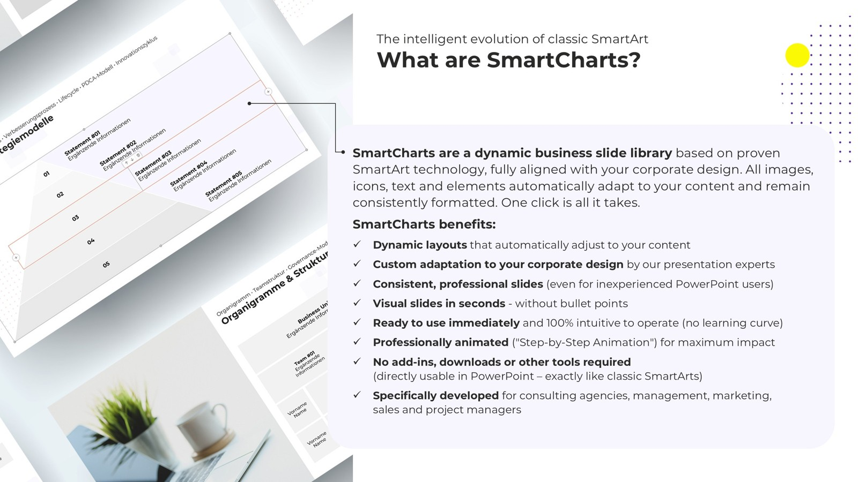

Slide 3
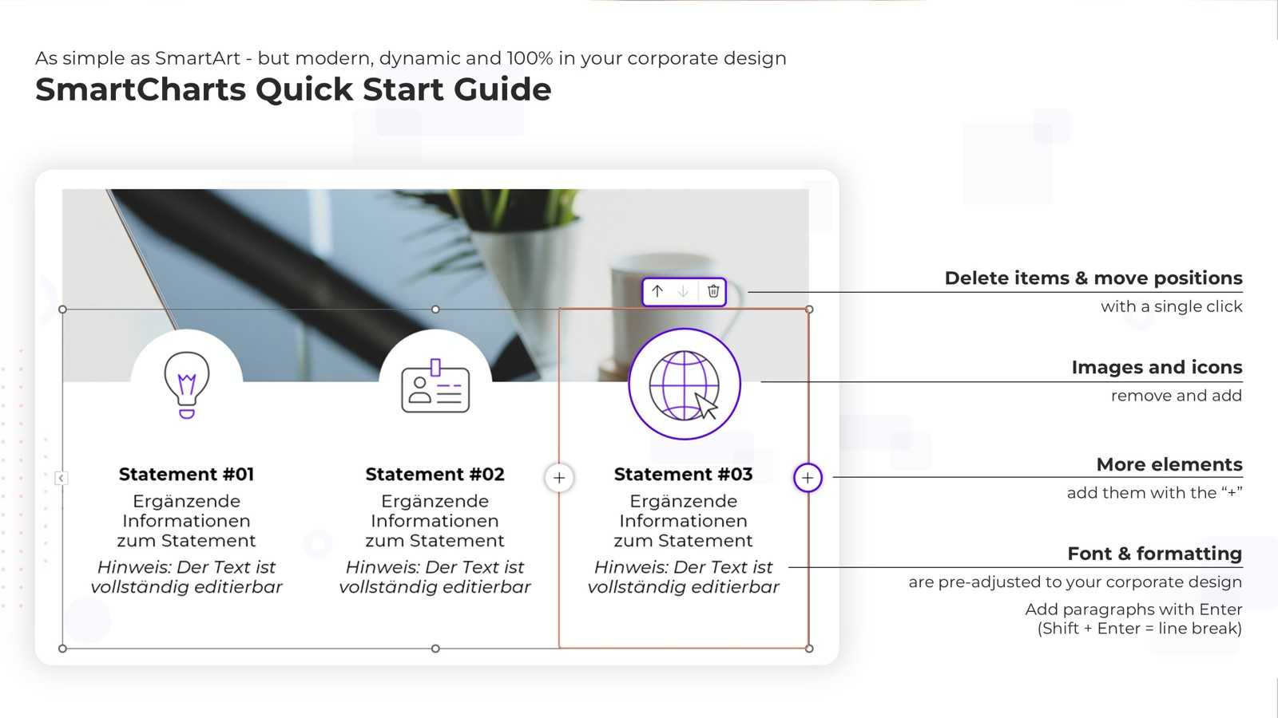

Slide 4
DEMO #1: Dynamically adapt statements & images
Dynamic. Intelligent. Flexible. See for yourself how SmartCharts automatically adapt to changes
Statement #01
Additional information about this statement in multiple lines
Statement #02
Additional information about this statement in multiple lines
Statement #03
Additional information about this statement in multiple lines
Statement #04
Additional information about this statement in multiple lines
Statement #05
Additional information about this statement in multiple lines

Slide 5
DEMO #2: KPI-Dashboard
Easily adjust images and statements
Statement #01
Additional information
Statement #02
Additional information
Statement #03
Additional information
Statement #04
Additional information
Statement #05
Additional information

Slide 6
DEMO #3: Presenting Roadmaps with pre-defined Animations
Switch to presentation mode: All SmartCharts are already perfectly animated
Milestone #01
Additional information
Milestone #02
Additional information
Milestone #03
Additional information
Milestone #04
Additional information
Milestone #05
Additional information

Slide 7
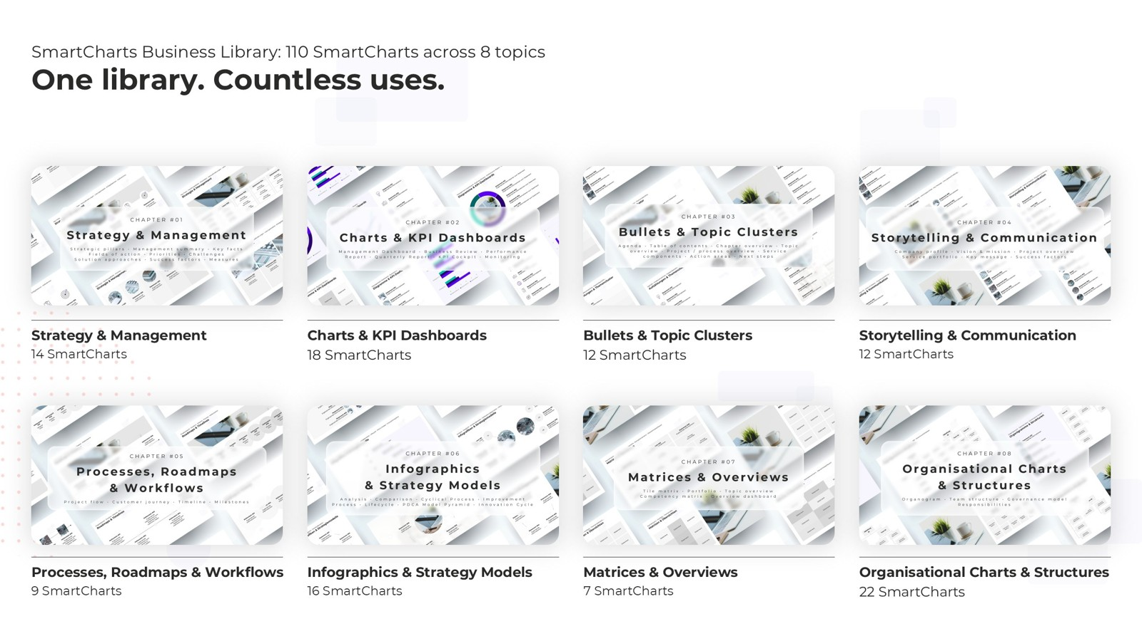

Slide 8


