Slide 1


Slide 2
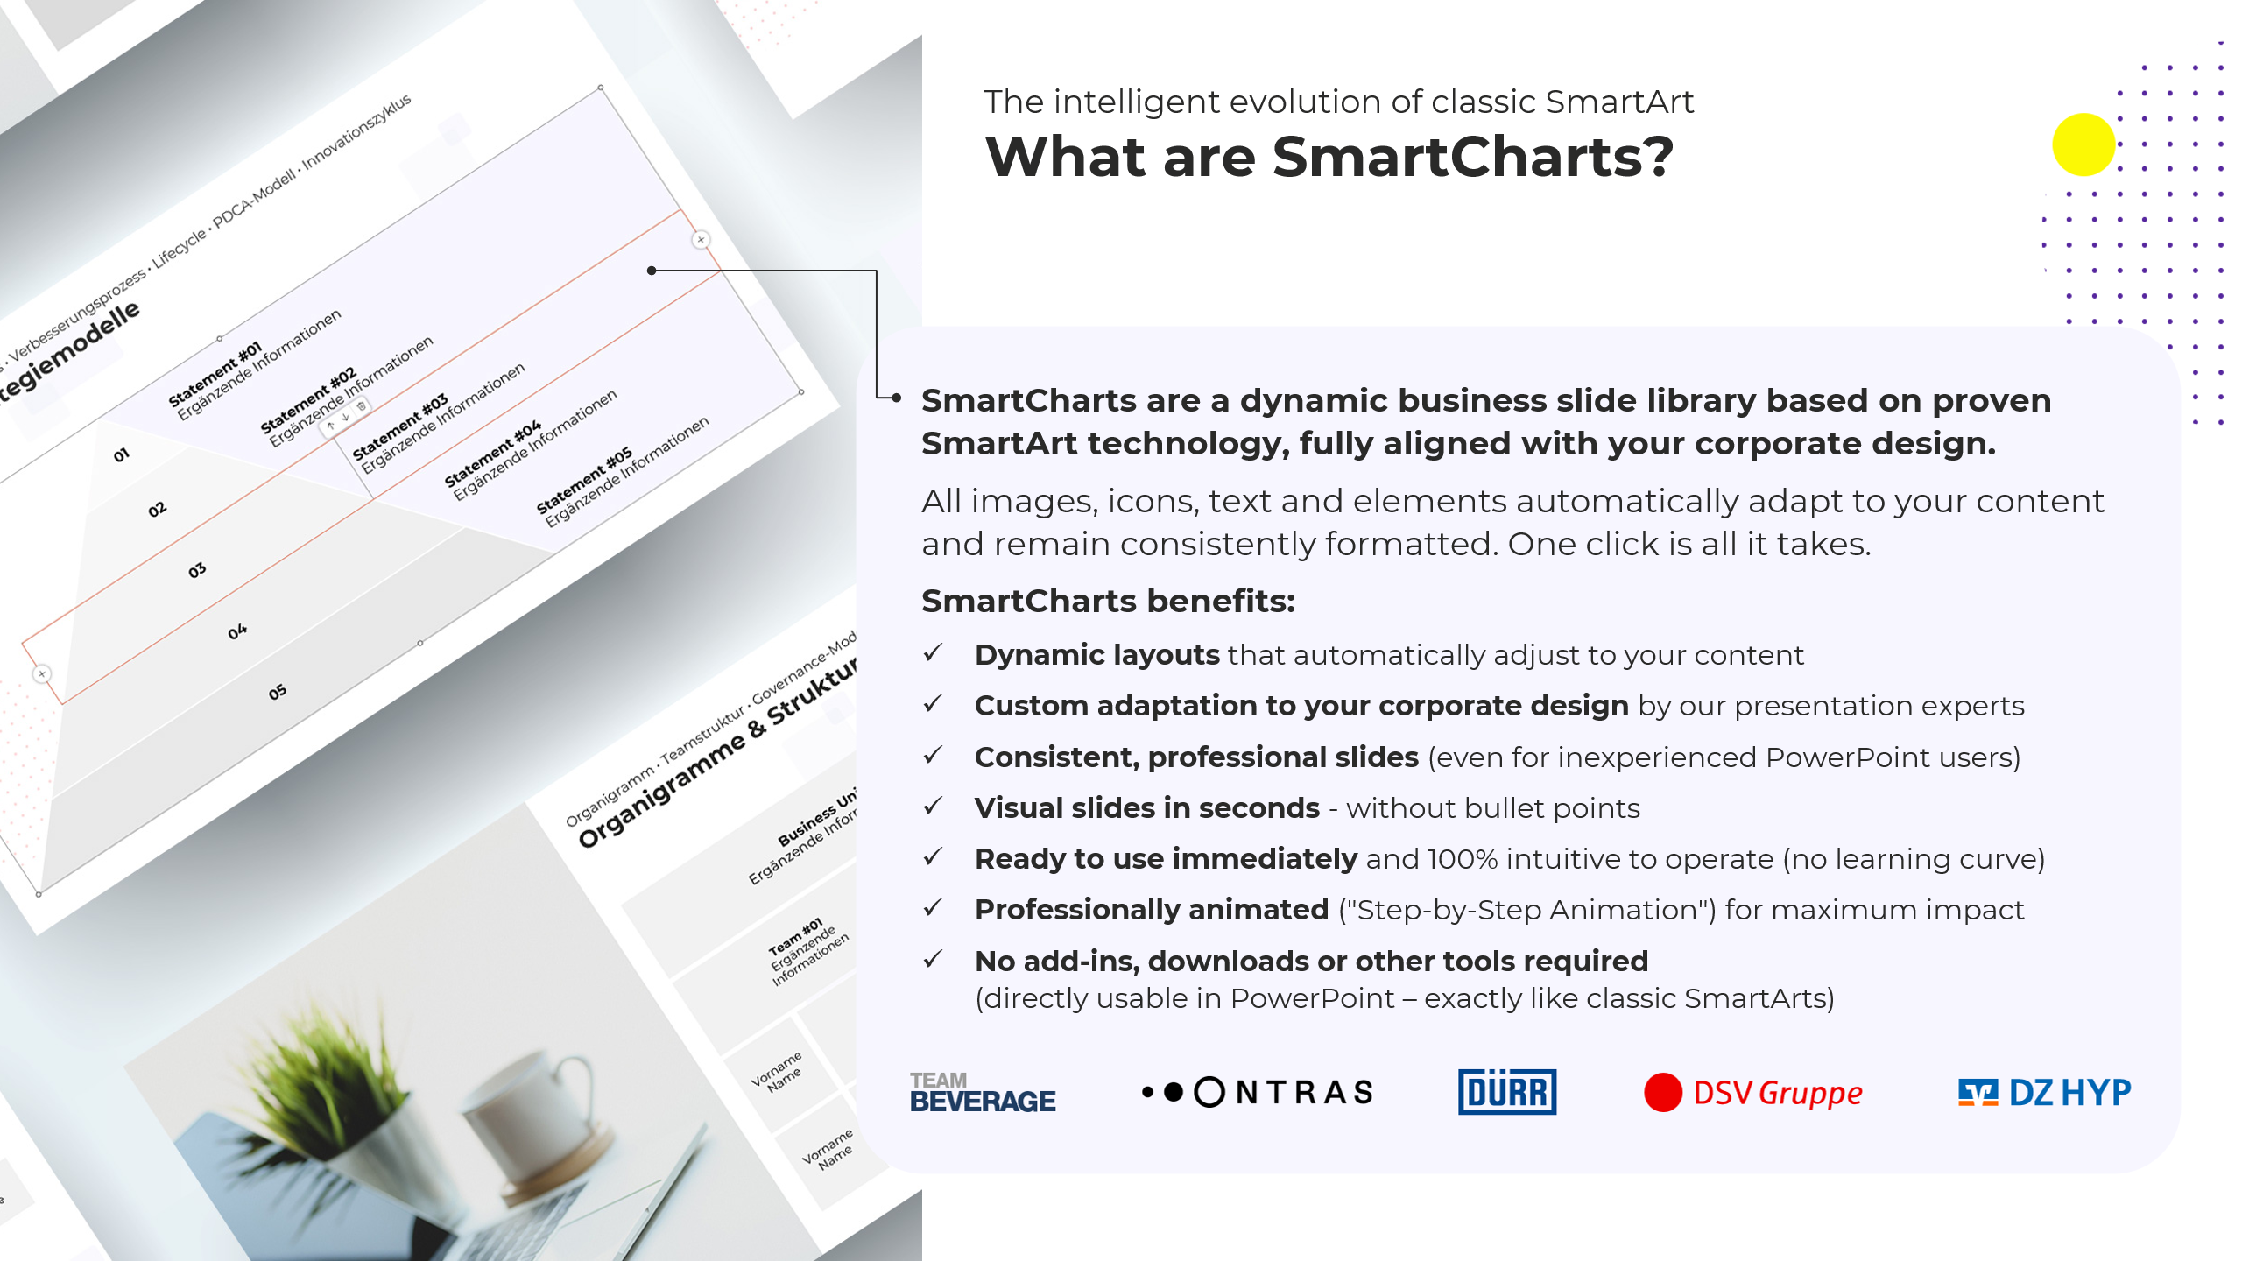

Slide 3
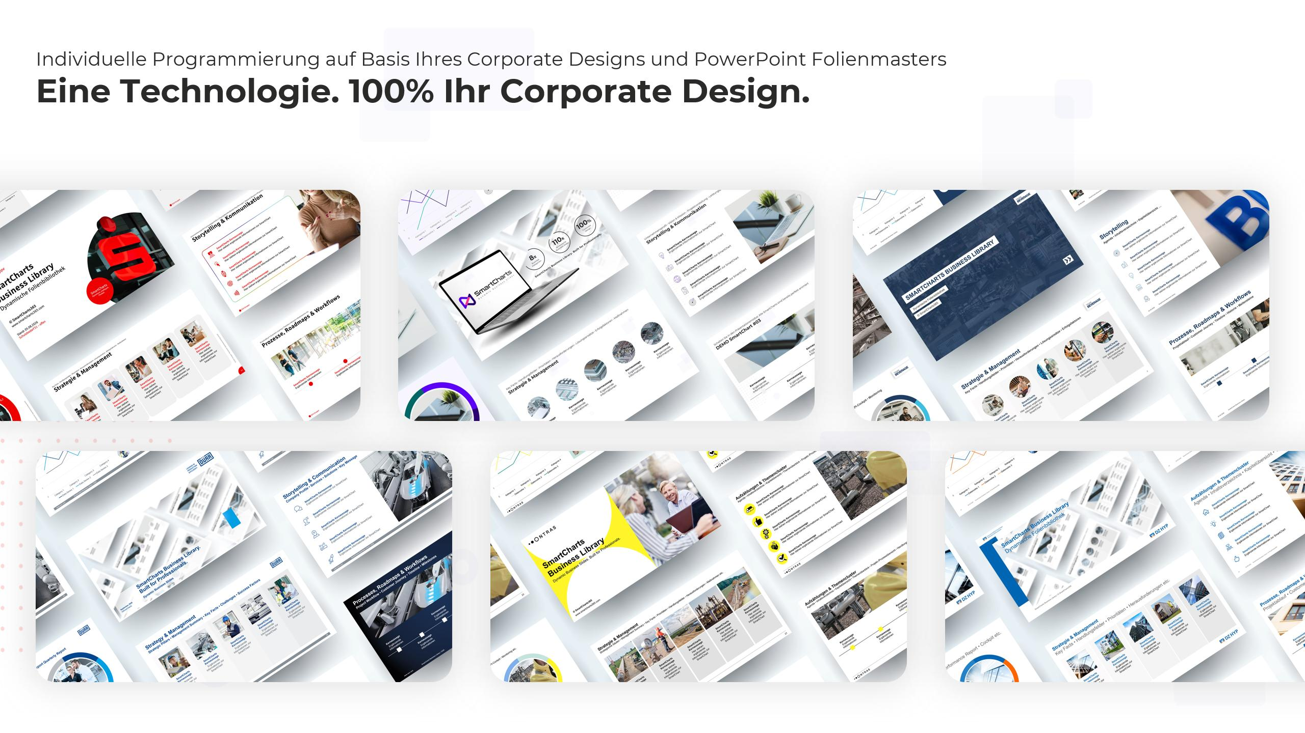

One Technology. 100% Corporate Design.
Custom programming based on your Corporate Design and PowerPoint Template

Slide 4
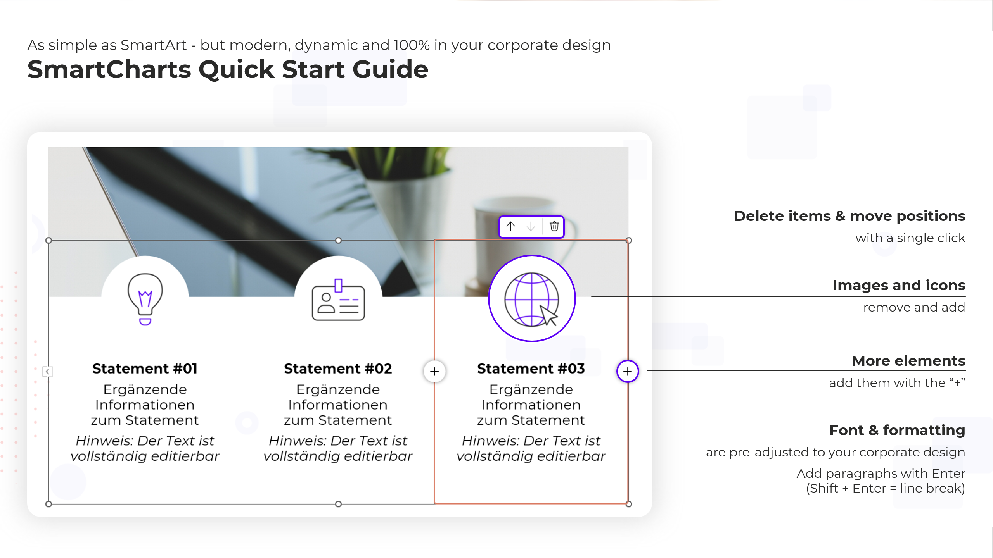

Slide 5
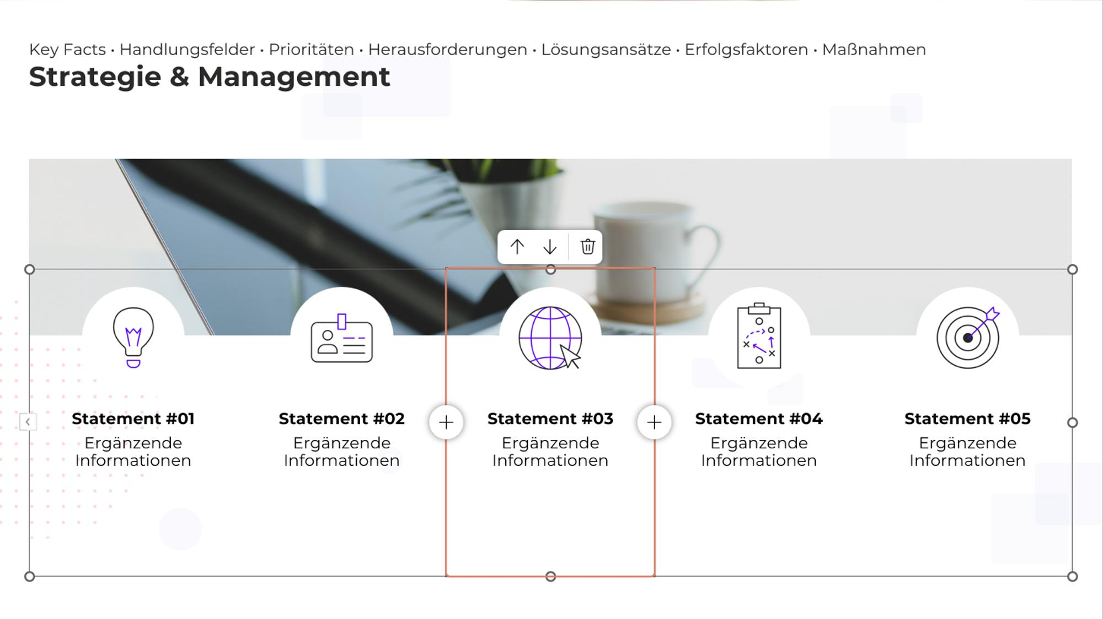
DEMO SmartChart #1: Key Facts
DEMO
SLIDE
Dynamic. Intelligent. Flexible. See for yourself how SmartCharts automatically adapt to changes.

Slide 6

DEMO SmartChart #2: Circular Process
DEMO
SLIDE
Dynamic. Intelligent. Flexible. See for yourself how SmartCharts automatically adapt to changes.

Slide 7
DEMO SmartChart #3: Chart + SmartChart Key Facts
DEMO
SLIDE
Dynamic. Intelligent. Flexible. See for yourself how SmartCharts automatically adapt to changes.

Slide 8
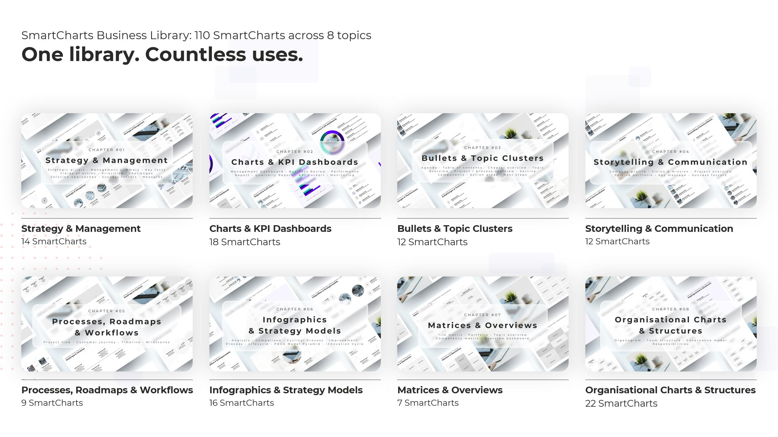

Slide 9


